Slide 1

Marketing Attribution
Analyze Data with SQL
Mario Giraldo
6/1/2025

Slide 2
Project Summary
Get familiar with the company.
How many campaigns and sources does CoolTShirts use and how are they related? Be sure to explain the difference between utm_campaign and utm_source.
What pages are on their website?
What is the user journey?
How many first touches is each campaign responsible for?
How many last touches is each campaign responsible for?
How many visitors make a purchase?
How many last touches on the purchase page is each campaign responsible for?
What is the typical user journey?
Optimize the campaign budget -> CoolTShirts can re-invest in 5 campaigns. Which should they pick and why?

Slide 3
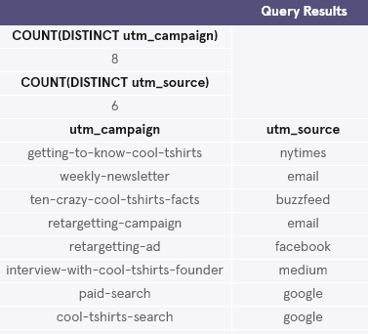
CoolTShirts data
-CoolTshirts has 8 different campaigns and uses 6 different sources to expose the campaigns.
-- Looking at sources and campaigns in page_visits table:
SELECT COUNT(DISTINCT utm_campaign)
FROM page_visits;
SELECT COUNT(DISTINCT utm_source)
FROM page_visits;
SELECT DISTINCT utm_campaign, utm_source
FROM page_visits;

Slide 4
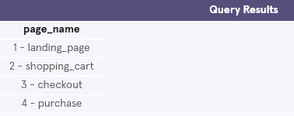
CoolTShirts data
-CoolTshirts website has 4 different pages shown below.
-- Finding distinct values of ‘page_name’ column:
SELECT DISTINCT page_name
FROM page_visits;

Slide 5
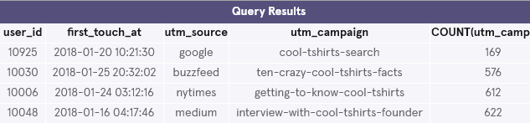
CoolTShirts – User Journey : first touches
-The amount of first touches each campaign received is found in the COUNT column below with the interview campaign receiving the most first touches (622) and the google search receiving the least amount of first touches(169).
-- Finding first touch amount per campaign:
WITH first_touch AS (
SELECT user_id,
MIN(timestamp) as first_touch_at
FROM page_visits
GROUP BY user_id)
SELECT ft.user_id,
ft.first_touch_at,
pv.utm_source,
pv.utm_campaign,
COUNT(utm_campaign)
FROM first_touch ft
JOIN page_visits pv
ON ft.user_id = pv.user_id
AND ft.first_touch_at = pv.timestamp
GROUP BY utm_campaign
ORDER BY 5 ASC;

Slide 6
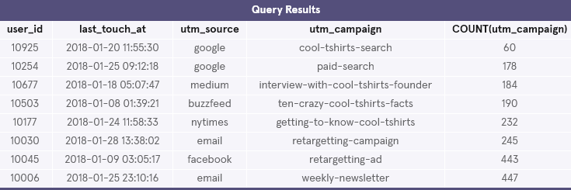
CoolTShirts – User Journey : last touches
-The amount of last touches each campaign received is found in the COUNT column below with the weekly newsletter sent out by email receiving the most last touches (447) and the google search receiving the least amount of first touches(60).
-- Finding last touch amount per campaign:
WITH last_touch AS (
SELECT user_id,
MAX(timestamp) as last_touch_at
FROM page_visits
GROUP BY user_id)
SELECT lt.user_id,
lt.last_touch_at,
pv.utm_source,
pv.utm_campaign,
COUNT(utm_campaign)
FROM last_touch lt
JOIN page_visits pv
ON lt.user_id = pv.user_id
AND lt.last_touch_at = pv.timestamp
GROUP BY utm_campaign
ORDER BY 5 ASC;

Slide 7
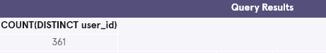
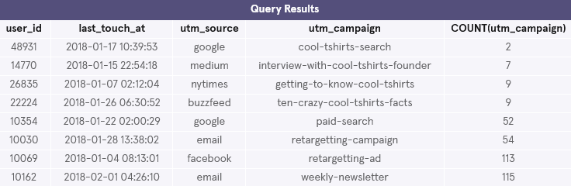
CoolTShirts – User Journey : purchase page
-361 users visited the purchase page
-The weekly newsletter campaign sent via email contributed to the most last touches on the purchase page (115)
-The google search campaign had the least amount of last touches on the purchase page (2).
-- Finding amount of purchases:
SELECT COUNT(DISTINCT user_id)
FROM page_visits
WHERE page_name = '4 - purchase’;
---Last touches on purchase page:
WITH last_touch AS (
SELECT user_id,
MAX(timestamp) as last_touch_at
FROM page_visits
WHERE page_name = '4 - purchase'
GROUP BY user_id)
SELECT lt.user_id,
lt.last_touch_at,
pv.utm_source,
pv.utm_campaign,
COUNT(utm_campaign)
FROM last_touch lt
JOIN page_visits pv
ON lt.user_id = pv.user_id
AND lt.last_touch_at = pv.timestamp
GROUP BY utm_campaign
ORDER BY 5 ASC;

Slide 8
CoolTShirts – Re-investment recommendation
-The 3 campaigns which had high counts of first touches (e.g. interview) would be good campaigns to build on by trying to make changes to the campaigns to streamline directing users to the purchase page.
-Focusing on which campaigns contributed to last touches on the purchase page might provide more value as they have already shown to contribute to more last touches on the purchase page.
-The 5 campaigns that contributed to the most last touches on the purchase page were :
1.)the weekly newsletter (email)
2.)retargeting-ad (facebook)
3.)retargeting-campaign (email)
4.)paid-search (google)
5.)ten-crazy-cool-tshirts-facts (buzzfeed)
-Given the weekly newsletter and retargeting campaigns contributed to 46% of the last touches on the purchase page and they reached users via email. It would be good to consider more campaigns reaching users via email.

